Slide 1
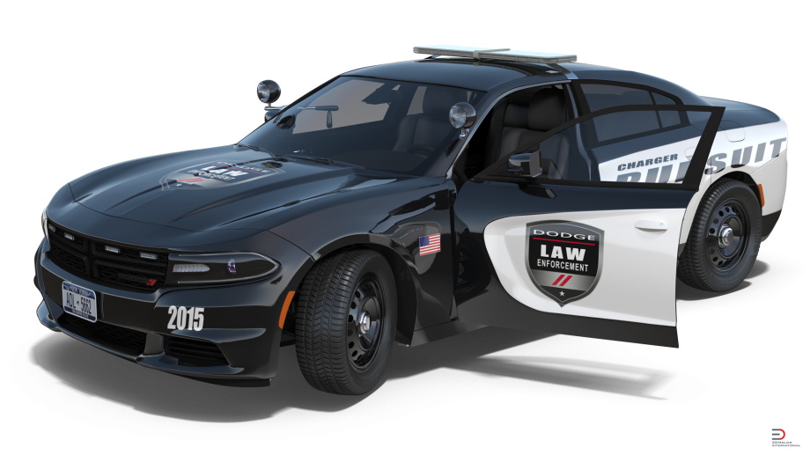
Project Proposal Interceptor 4.0 AUTONOMOUS LAW ENFORCEMENT Vehicle
Team Delamain
Hideaki Heng Lee, Nicolas Morant, Jack Tsu
DGMD E-17 - HARVARD UNIVERSITY – SPRING 2021

Slide 2
1. introduction

Slide 3
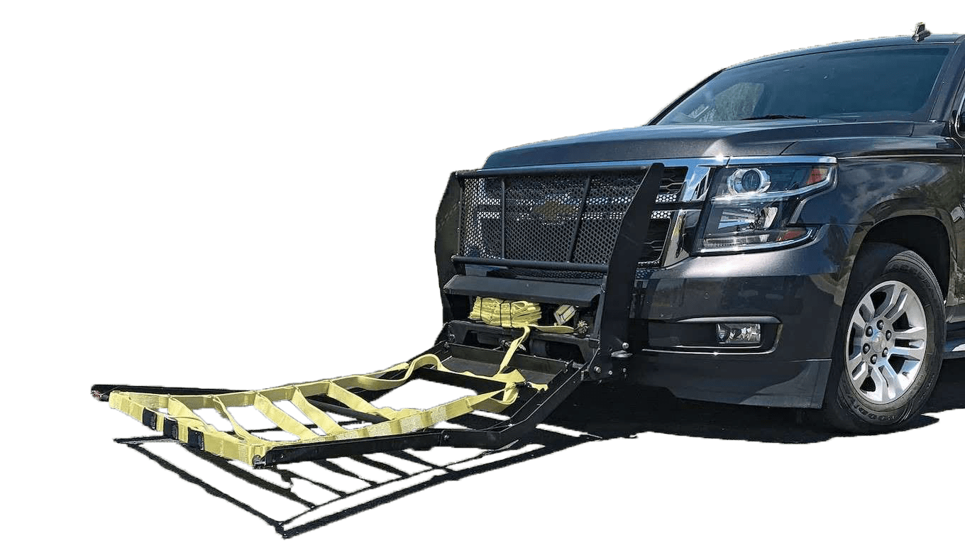

1.1 Goal of the project
Team Delamain wants to build Interceptor 4.0, a level 4 autonomous law
enforcement vehicle that patrols neighborhoods and when needed chases vehicles. The challenges Interceptor 4.0 will face are as follows: lane detection, object avoidance, GPS navigation, self-parking, specific vehicle tracking, and more. In addition it will need to follow the rules of law and during a pursuit should have the ability to ignore them while maintaining safety for its user and surroundings.
This autonomous vehicle would enable to increase the safety of law enforcement officers and people around them. It will be more reliable for chasing vehicles as no human will be able to runout from our AI. Officers will also be able to multitask in their Interceptor 4.0 while chasing a vehicle, enabling them to coordinate road blocks, spike strip, and more. In addition the Interceptor 4.0 will facilitate law enforcement agencies to have more coverage without having the need for more personal. Finally, Interceptor 4.0 could be equipped with a Grappler Police Bumper in order to safely stop the vehicle it is pursuing instead of using a dangerous pit maneuver.

Slide 4
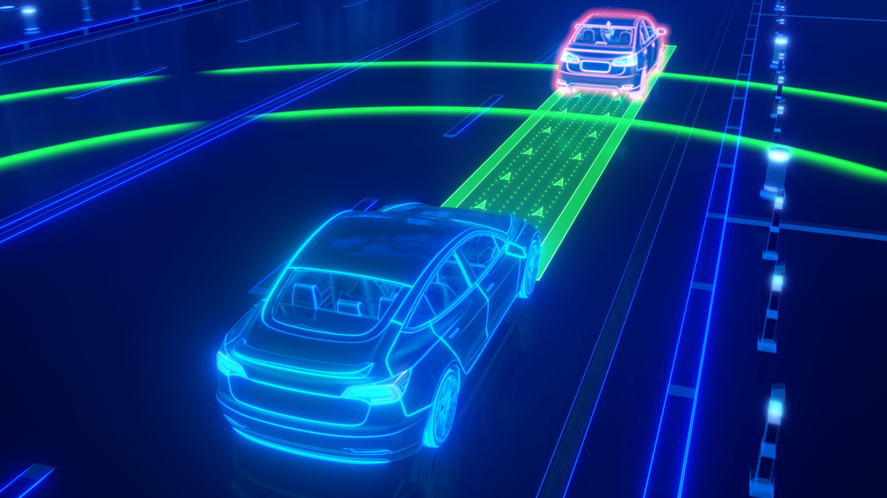
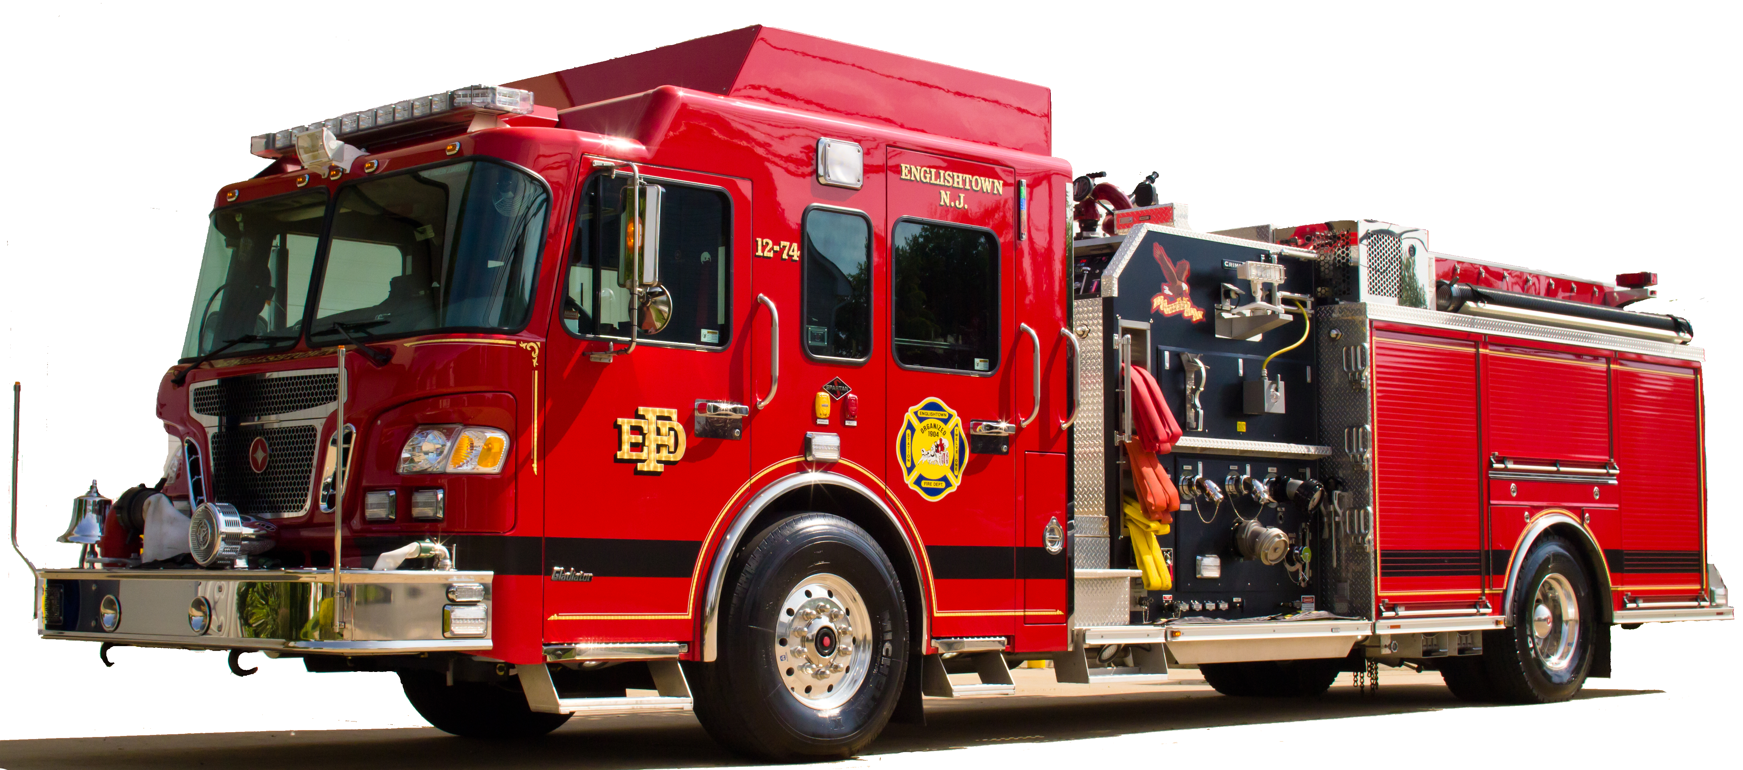
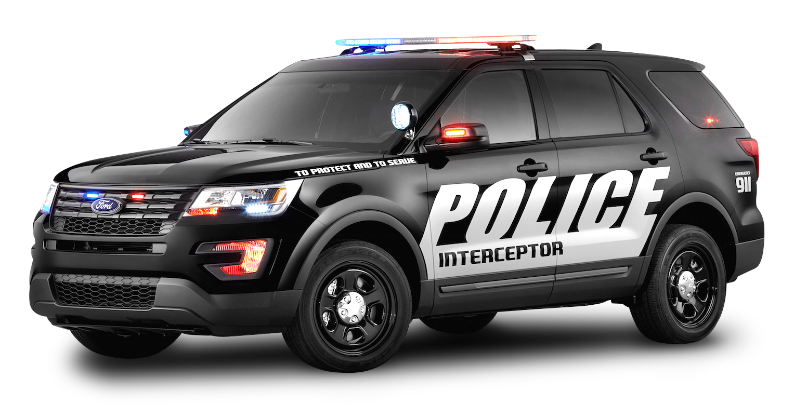
1.2 Level of Autonomy
Level 4 of autonomy
Highly automated car
Full self-driving under certain conditions
Equipped with a multitude of sensors
Camera, LIDAR, GPS
Optional: Radar, Semantic Camera
Target Market:
Main: First Responders
Secondary: General Public (adapted)

Slide 5
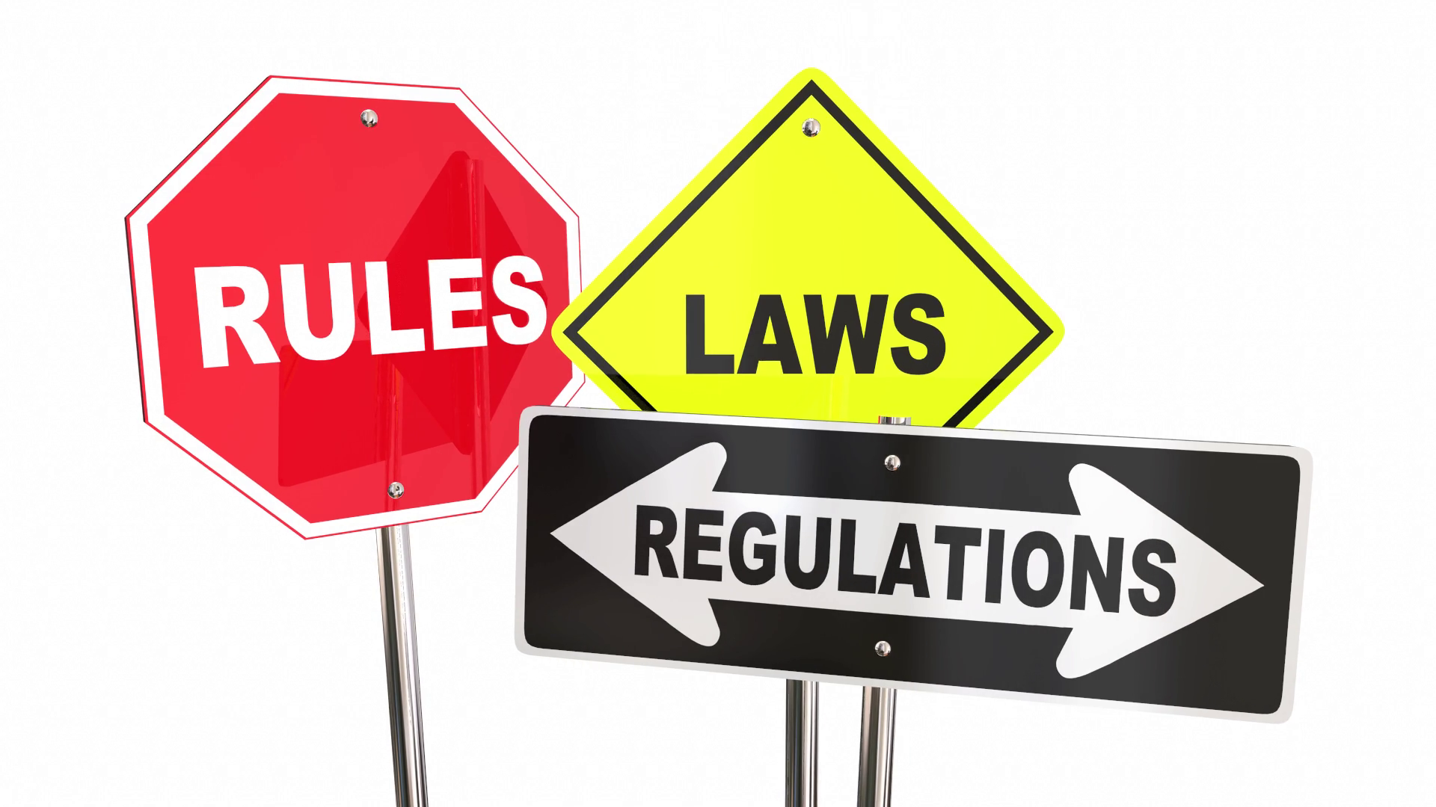
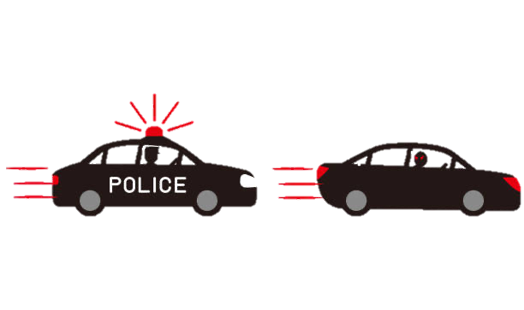


1.3 Description
Base:
Follow rules of law
Lane detection & tracking
Collision avoidance (object classification)
Signs/Lights detection
Intersections handling
3 Autonomous Scenarios:
GPS Navigation
Car Chasing
Self-Parking

Slide 6
2. Related Work

Slide 7

2.1 Inspiration
https://github.com/JahodaPaul/autonomous-car-chase
https://medium.com/xrpractices/autonomous-car-parking-using-ml-agents-d780a366fe46
https://github.com/expectopatronm/platooning-demonstrator
https://github.com/carla-simulator/imitation-learning
https://thomasfermi.github.io/Algorithms-for-Automated-Driving/Introduction/intro.html
https://github.com/Amin-Tgz/awesome-CARLA
https://www.openbot.org/
https://github.com/FoamoftheSea/mod6project
https://medium.com/asap-report/training-a-neural-network-for-driving-an-autonomous-rc-car-3906db91f3e
https://ai.googleblog.com/2019/01/soft-actor-critic-deep-reinforcement.html
https://github.com/PacktPublishing/Hands-On-Intelligent-Agents-with-OpenAI-Gym/tree/master/ch7#2-carla-gym
https://github.com/KaiChen1008/Sim-to-Real-Virtual-Guidance-for-Robot-Navigation
https://www.mdpi.com/2504-446X/3/3/58/htm
https://github.com/vignif/carla-parking
https://policebumper.com/

Slide 8
3. Team Organization

Slide 9

3.1 Team Members and roles
Zhongheng (Heng) Li :
Object Detection + Chasing + Sim2real
Nicolas Morant:
GPS Navigation + Self Parking
Huayu (Jack) Tsu:
Lane Tracking + Intersection

Slide 10
4. Software and developing tools

Slide 11







4.1 Software

Slide 12


4.2 Laptop/Desktop Setup
Desktop computers
Recommended requirements:
Intel i7/i9 gen. 9th - 11th or AMD Ryzen 7/9
+16 GB RAM memory
NVIDIA RTX 2070 or higher
Windows or Ubuntu

Slide 13
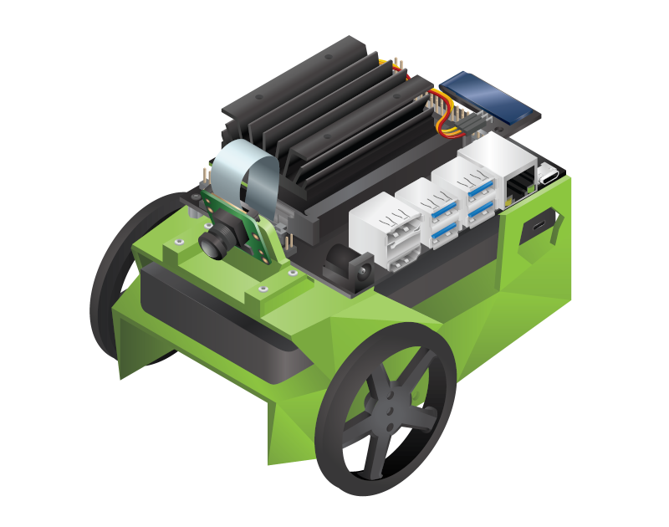
4.3 Hardware needed (BONUS PHASE)
Bonus Phase for Sim2Real:
JetBot AI Robot Kit
Including NVIDIA Jetson Nano

Slide 14
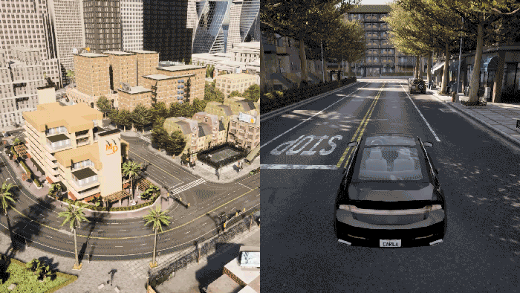
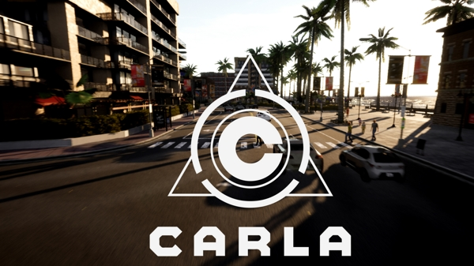
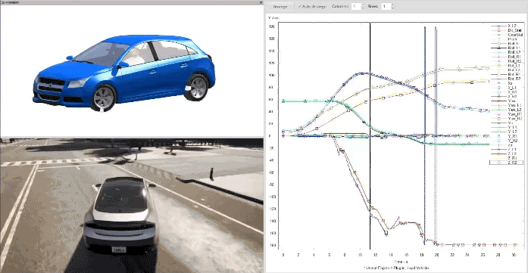
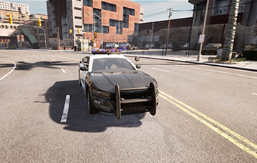
4.4 Simulator needed
CARLA Simulator (https://carla.org/)

Slide 15
5. List of Milestones

Slide 16

5.1 Outline and schedule
Week | Date | Milestone
3 | 8-Feb | Setting up our desktops and installing CARLA simulator
4 | 15-Feb | Testing Carla simulator’s features and functionalities
5 | 22-Feb | Writing project proposal
6 | 1-Mar | Project proposal submission (28-Feb)
7 | 8-Mar | Phase 1: Lane Tracking; GPS Navigation; Object Detection - Demo
8 | 15-Mar | Phase 1 features - Finalized
9 | 22-Mar | Phase 2: Intersection; Self-Parking; Vehicle-reID - Demo
10 | 29-Mar | Phase 2: features - Finalized
11 | 5-Apr | Phase 3: Integration - Planning
12 | 12-Apr | Phase 3: Integration - Demo
13 | 19-Apr | Phase 3: Integration - Finalized
14 | 26-Apr | Presentation preparation + Bonus phase
15 | 3-May | Project submission and presentation

Slide 17
5.2 Phases
Enable Baseline in CARLA Simulator
Tasks:
Lane Tracking
GPS Navigation
Object Detection
Integration
Tasks:
Fuse all scenarios from phase 1 & 2
PHASE 1
PHASE 2
PHASE 3
BONUS PHASE
Self-Driving Capability Enhancements
Tasks:
Intersection Handling
Self-Parking
Vehicle Reidentification
Deploy to JetBot
Tasks:
Test car start, stop and car chasing in JetBot
Enable continuously generate real world dataset

Slide 18
6. Team meeting Schedule

Slide 19

6. Team meeting Schedule
More meetings will be added as needed throughout the semester.

Slide 20

INTERCEPTOR 4.0
COMING SOON
TEAM DELAMAIN

